Slide 1
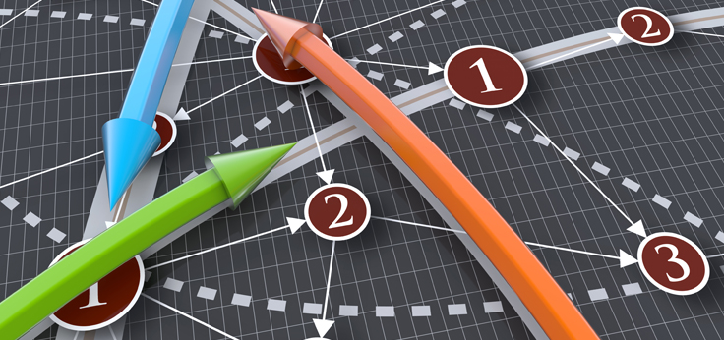
Introduction to Operations Research (OR) -Linear programming
& Simplex Method
Lecture 12

Slide 2
A travel to the past- Origins of OR
The beginning of the activity called operations research has generally been attributed to the military services early in World War II. Because of the war effort, there was an urgent need to allocate scarce resources to the various military operations and to the activities within each operation in an effective manner. Therefore, the British and then the U.S. military management called upon a large number of scientists to apply a scientific approach to dealing with this and other strategic and tactical problems. In effect, they were asked to do research on (military) operations. These teams of scientists were the first OR teams.

Slide 3
A travel to the past- Origins of OR
After the war, many of the scientists who had participated on OR teams or who had heard about this work were motivated to pursue research relevant to the field; important advancements in the state of the art resulted. A prime example is the simplex method for solving linear programming problems, developed by George Dantzig in 1947.
A second factor that gave great impetus to the growth of the field was the onslaught of the computer revolution. A large amount of computation is usually required to deal most effectively with the complex problems typically considered by OR. Doing this by hand would often be out of the question. Therefore, the development of electronic digital computers, with their ability to perform arithmetic calculations thousands or even millions of times faster than a human being can, was a tremendous boon to OR.

Slide 4
Linear Programming
The development of linear programming has been ranked among the most important scientific advances of the mid-20th century.
The most common type of application involves the general problem of allocating limited resources among competing activities in a best possible (i.e., optimal) way.
Linear programming uses a mathematical model to describe the problem of concern. The adjective linear means that all the mathematical functions in this model are required to be linear functions. The word programming does not refer here to computer programming; rather, it is essentially a synonym for planning. Thus, linear programming involves the planning of activities to obtain an optimal result, i.e., a result that reaches the specified goal best (according to the mathematical model) among all feasible alternatives.

Slide 5
Linear Programming-Problem Formulation
First ask three questions
What variables or unknowns are involved?
What quantity is to be maximized or minimized and how do I express that quantity in terms of my unknowns?
What constraints do I have? How can I express those constraints in terms of my unknowns? (In linear programming problems, this step results in a set of linear inequalities)

Slide 6
Example 1: Potter making cups and plates
A potter is making cups and plates. It takes her 6 minutes to make a cup and 3 minutes to make a plate. Each cup uses 3/4 lb. of clay and each plate uses one lb. of clay. She has 20 hours available for making the cups and plates and has 250 lbs. of clay on hand. She makes a profit of $2 on each cup and $1.50 on each plate. How many cups and how many plates should she make in order to maximize her profit?
Formulate the problem.

Slide 7
Example 2
A calculator company produces a scientific calculator and a graphing calculator. Long-term projections indicate an expected demand of at least 100 scientific and 80 graphing calculators each day. Because of limitations on production capacity, no more than 200 scientific and 170 graphing calculators can be made daily. To satisfy a shipping contract, a total of at least 200 calculators much be shipped each day. If each scientific calculator sold results in a $2 loss, but each graphing calculator produces a $5 profit, how many of each type should be made daily to maximize net profits?

Slide 8
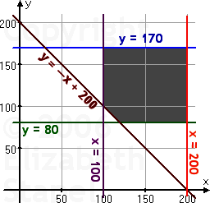
Solution
Maximize z = –2x + 5y
Subject to,
x≥100
y≥80
x≤200
y≤170
x+y≥200

Slide 9
Example 3
A transport company has two types of trucks, Type A and Type B. Type A has a refrigerated capacity of 20 m³ and a non-refrigerated capacity of 40 m³ while Type B has the same overall volume with equal sections for refrigerated and non-refrigerated stock. A grocer needs to hire trucks for the transport of 3,000 m³ of refrigerated stock and 4,000 m³ of non-refrigerated stock. The cost per kilometer of a Type A is $30, and $40 for Type B. How many trucks of each type should the grocer rent to achieve the minimum total cost per km?

Slide 10
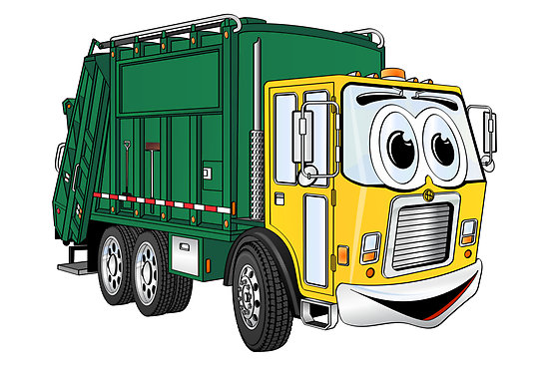
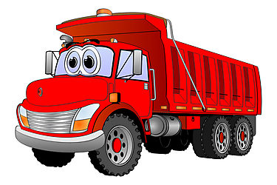
Formulation
Let, x = number of type A trucks
And, y = number of type B trucks
Minimize z = 30x + 40y
Subject to, 20x+ 30y≥ 3000
40x+ 30y≥ 4000
x , y ≥ 0

Slide 11
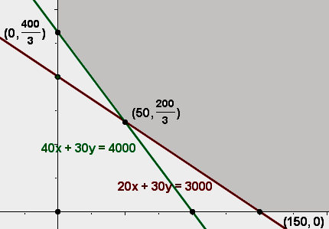

Solution

Slide 12
Solving LP problems by
Simplex Method
In this chapter we will solve LP problems of Standard Form only.
Standard form:
Objective Function will be of Maximization
All the functional constraints will have ≤ sign (no ≥ or = signs for the constraints)
Decision Variables will have non negative value (non negative constraints)

Slide 13
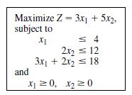

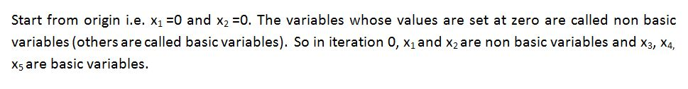
Solving LP problems by
Simplex Method
Step 1. Turning the inequalities into equalities

Slide 14
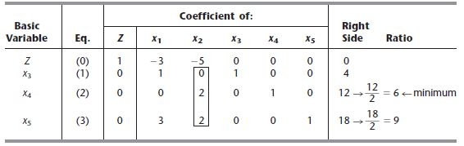
Solving LP problems by
Simplex Method
Step 2. Writing the initial board simplex

Slide 15
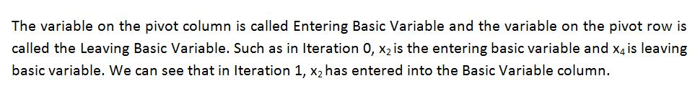
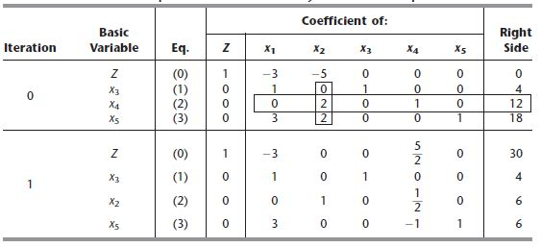
Solving LP problems by
Simplex Method
Step 3: Iterations

Slide 16
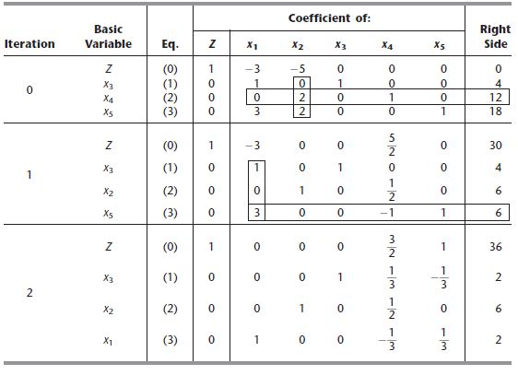
Solving LP problems by
Simplex Method

Slide 17
Solving LP problems by
Simplex Method
Termination Criteria: When at the Z row there aren't negatives values, the optimal solution of the problem has been reached. In such a case, the algorithm has finished.
The optimal solution is given by the Z value, at the column of the solution values, in this case: 36. In the same column, watching the rows correspondents to the decision variables that come at base: (x,y) = (2,6)

Slide 18
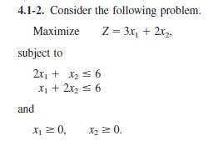
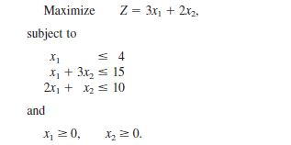


Practice Problem
Solve by using Simplex Method
1.
2.

Slide 19


